Slide 1

Enhancing Leisure Destinations International’s IT Operations

Slide 2
Agenda
Introduction
Recommendation
Implementation
Financials
Risks and Mitigation
Conclusion
Introduction
2

Slide 3




Meet the Team
Shane Rodriguez
Garrett Williams
Jong Won Choi
Anirban Das
Introduction
3

Slide 4

Strengthening LDI IT to Drive Sustainable Growth and Efficiency
LDI is a premier resort management company experiencing rapid growth across 13 resort villages worldwide. As LDI scales, IT has a critical role in supporting business operations, enhancing customer experience, and enabling data-driven insights.
LDI’s IT environment is fragmented, with an ineffective security model, decentralized service desks, and incompatible systems run in multiple datacenters. These inefficiencies limit IT’s scalability, increase operational costs, and expose the company to security risks, hindering IT’s role as a growth enabler.
What strategic initiatives should LDI prioritize to ensure IT is a key driver of growth, operational excellence, and customer satisfaction?
ITS - The IT Challenge
Introduction
4

Slide 5


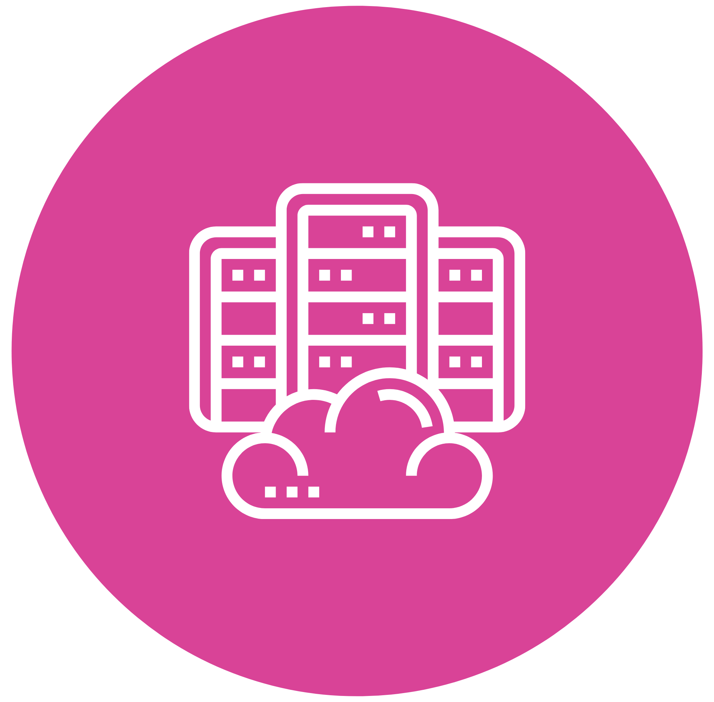
Centralize and Standardize LDI’s IT Operations to Drive Security, Efficiency, and Consistency
Centralized Security and Compliance Protocols
Centralizing security and compliance protocols will improve security measures, identity management, and help meet regulatory standards. As a result, LDI can better protect data, improve access management, and ensure compliance.
Standardized IT Service Management
Standardizing IT service management will make LDI's operations more efficient and improve service quality. This will lower costs, and speed up incident resolution, leading to a better user experience.
Consolidated Data Centers
Reduce costs and improve efficiency by merging multiple regional data centers into one highly efficient central facility. This will reduce operational costs, enhance scalability, disaster recovery, and overall IT performance.
Recommendations
5

Slide 6










Enhance Security with MFA, SSO, and Centralized Access Controls
Present State
Future State
LDI’s decentralized security structure fragments protocols and controls
LDI’s centralized security framework enhances access, monitoring, and compliance
Isolated data centers
Slow incident response
Centralized IAM System
Centralized Monitoring
Manual access management delays
Limited SSO and MFA protection
SSO & MFA
Compliance
Fragmented access controls
Automated Provisioning
A centralized security framework with unified protocols, streamlined access controls, and rapid incident response, will enhance both security and regulatory compliance
IT GRC – Introduction to IT GRC and ITG
Recommendations
6

Slide 7

Establish IT Service Consolidation and Centralized Helpdesk to Enhance Employee Efficiency
Present State
Future State
SLA1
SLA2
ITSM Platform
Standard SLA
Incident Management
Request Fulfillment
Change Management
Service Management
Central Helpdesk
Regional Helpdesk
SLA3
User Confusion
Inconsistent Service Quality
Unified Helpdesk
Application Helpdesk
Standard Operating Procedures
Delayed Response
An integrated ITSM platform at LDI would manage incidents quickly, fulfill requests efficiently, prevent recurring issues, and uphold service levels to align with business goals
ITS – OCM
IT GRC - ITRM, Cybersecurity, IR
Recommendations
7

Slide 8


Consolidate Data Centers for Cost Efficiency and Scalability
Present State
Future State
Multiple regional data centers, redundant applications, and scattered storage systems
One main data center running necessary applications with a backup site for redundancy
HQ
Regional
Regional
Regional
Large HQ DC
Mirror
SQL Server
DB2
Oracle
Oracle
SQL Server
SQL Server
Duplicate shared applications
SQL Server
Mirroring
Consolidating LDI’s data centers will streamline operations, reduce costs, and create a scalable IT foundation that supports growth and enhances service reliability across all locations
DCA – Introduction and Software Architecture P2
Recommendations
8

Slide 9

Suggested Progress Metrics for Project Completion and Effectiveness
Project Completion Rate
Project
Milestone
0.00
49%
100.0
Implementation
9

Slide 10
Three Year Rollout for Selected Project Completion
 | Year 1 Year 2 Year 3
Steps | Q1 | Q2 | Q3 | Q4 | Q5 | Q6 | Q7 | Q8 | Q9 | Q10 | Q11 | Q12
Planning and Assessment
Centralized IAM System
IT Service Consolidation
Data Center Consolidation
Testing & Optimization
Full Deployment
Documentation & Support
Continuous Improvement
Project Evaluation & Reporting
Implementation
10

Slide 11
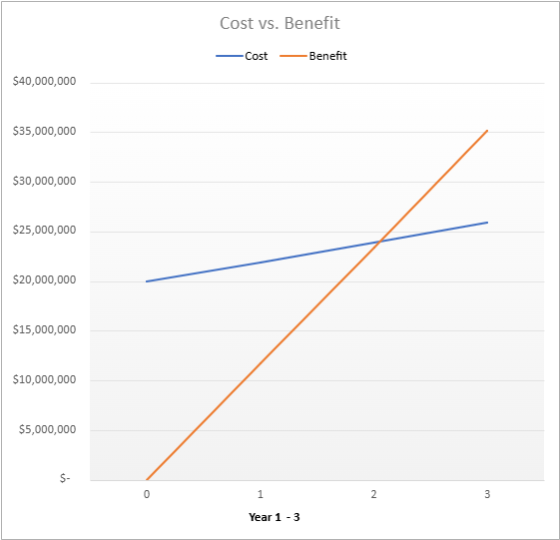
LDI Reaches Breakeven at the Beginning of Year 3
Cost and Benefit Breakdown
Total one-time costs: $19,925,000 Total recurring costs: $5,938,200 Total costs: $25,863,200 Year 1 benefits: $11,700,000 Year 2 benefits: $11,700,000 Year 3 benefits: $11,700,000 Total benefits: $35,100,000
Key Assumptions
Security breach avoidance accounted for every year WACC is 9.45% IT staff for helpdesk and datacenters are relocated from regional facilities
NPV = $4,483,303 ROI = 36% B/E: Year 3
Financials
11

Slide 12


Understanding and Addressing Key Risks to implement a Successful IT Transformation at LDI
Risk | Degree | Mitigation Strategy
The implementation of new IAM and SSO solutions may expose sensitive data if not properly secured |  | Implement strong encryption methods for data at rest and in transit, conduct regular security audits, and ensure compliance with data protection regulations. Establish strict access controls and monitor access logs continuously
Employees may resist new processes and systems, leading to poor adoption and potential project failure |  | Develop a comprehensive change management plan that includes stakeholder engagement, regular communication, and training programs. Highlight the benefits of new systems and involve employees in the implementation process to foster a sense of ownership
Existing systems may not integrate smoothly with the new ITSM platform and IAM solutions, causing delays and functionality issues |  | Conduct a thorough analysis of current systems to identify integration points and potential issues. Utilize APIs and middleware to facilitate integration. Establish a phased implementation approach to address integration challenges progressively
Severity
Probability
Severity
Probability
Severity
Probability
Risks & Mitigation
12

Slide 13
Our Strategic Vision for LDI is a Secure, Standardized, and Cost-Effective IT Transformation
Present State
Fragmented Security allows for user data breaches
Unstandardized ITSM and Service Desk processes
Duplicate applications spread across data centers
Future State
Centralized Security
Standardize IT Service
Data Center Consolidation
Unified Identity and Access Management system with Multi-Factor Authentication and SSO that ensures all user access is controlled, and extra protection layer is applied
Centralized IT Service Management platform and Standard Operating Procedures that will streamline processes & accountability, reduce inefficiencies, and ensure consistent service delivery
Single, scalable data solution and backup & disaster recovery plan that reduces operational costs and improves resource management and ensure business continuity and data integrity
Let’s lead this transformative journey with our proven expertise in enhancing IT infrastructure, ensuring robust security, and streamlining operational processes
Conclusion
13

Slide 14
Appendices
AI Affirmation
Class Slides
Financial Assumptions
Extended Recommendations
Financial Calculations
Extended Risks
Other Options Considered
Financial Assumptions
Extended

Slide 15
AI Affirmation
We affirm that we have not used generative AI on this presentation
GW SR AD JWC

Slide 16
Class Slides Used
ITS – IT Portfolio Management
ITS - The IT Challenge
DCA – Introduction and Software Architecture P2
IT GRC – Introduction to IT GRC and ITG
ITS – IT Cost
ITS - Advanced CA2 (MINTO Principles)
ITS – Case Analysis Financials
IT GRC_ITRM, Cyber, IR_ISACA_Track These 7 Trends for Proactive Cybersecurity_2024

Slide 17
Outcome based approach will help solutions make meaningful impact on the organization
Centralized Security Framework
Comprehensive Security
MFA and SSO Implementation
Standardized IT Service Management (ITSM)
Unified Service Delivery
SLA & SOP Implementation
Data Center Consolidation
Backup and Redundancy
Cost Efficiency & Scalability
Centralized IAM with MFA and SSO offers robust, industry standard security, ensuring consistent access control and reducing the risk of data breaches across all locations
A centralized ITSM platform streamlines service delivery, improves incident resolution times, and ensures consistent service levels across all resorts, leading to higher efficiency and user satisfaction
Consolidating data centers reduces costs, improves scalability, and simplifies management while enhancing redundancy and disaster recovery capabilities

Slide 18
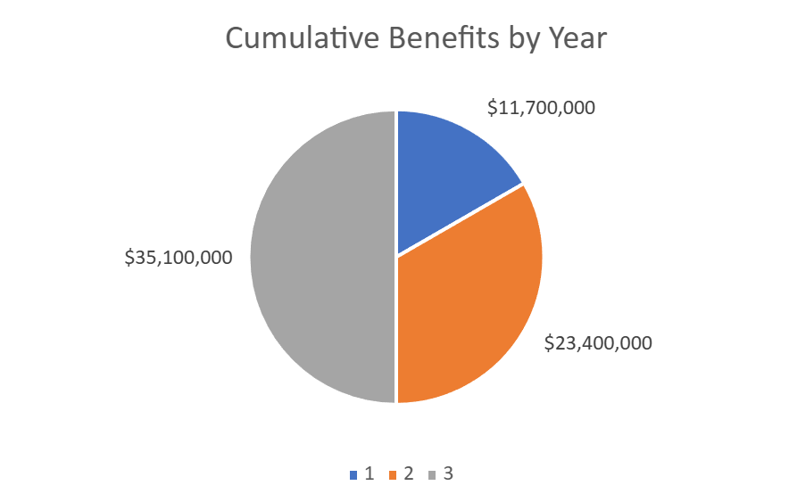
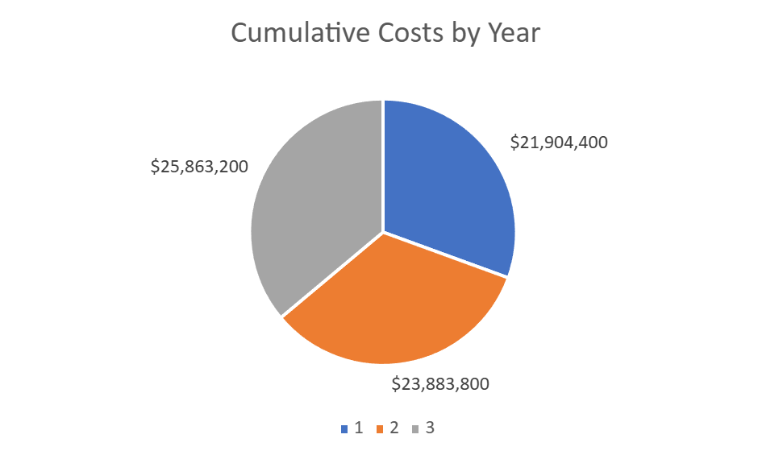
Financial Assumptions
IT Budget 5% of Sales
Sources:
Cost of SSO/MFA | The SSO Wall of Shame | A list of vendors that treat single sign-on as a luxury feature, not a core security requirement.|What does MFA cost to implement and maintain
HQ Datacenter remodel | How Much Does it Cost to Build a Data Center? - Dgtl Infra
Server Hardware | Intel Servers Processors | ThinkSystem Servers | Xeon CPUs for Server | Lenovo US
Helpdesk solution price | Outsourced Help Desk Pricing in 2024 [+Cost Calculator]
Datacenter Power/HVAC cost | Best Data Center Build Out Cost: Top 5 Key Factors
Security Breach Cost Avoidance | Cost of a data breach 2024 | IBM
Improved customer experience revenue | Prediction: The future of Customer Experience | McKinsey
INVESTMENTS | COMPETITIVE ADVANTAGE 15% | FUTURE OPPORTUNITY 10%
 | CORE PROCESSES 20% | SUPPORTING THE BUSINESS 10%
OPERATIONS | PLANNED UPGRADES 25% | GENERAL MAINTENANCE 20%
INVESTMENT: 55% | OPERATIONS: 45%
Avg. Project Size: $ Tens of millions | Planned/General: 5/4
Benefits-Costs: $ | Cost per PC: $

Slide 19
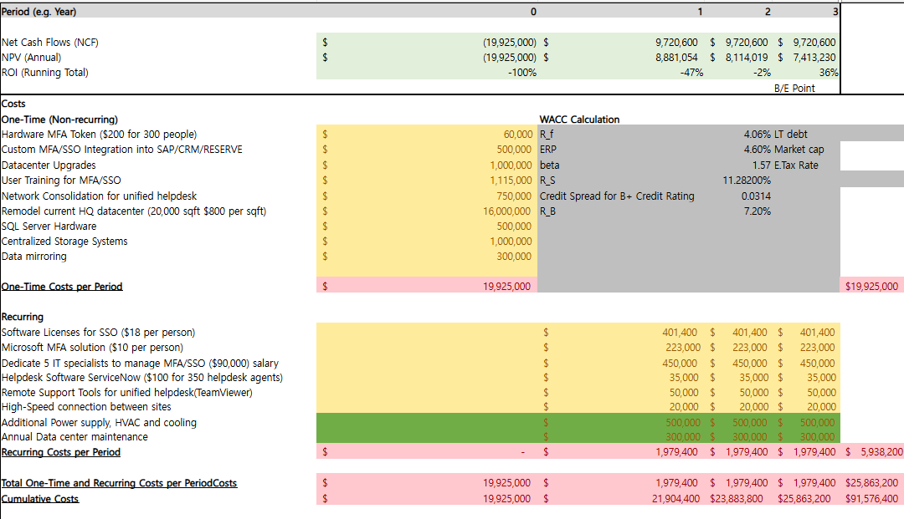
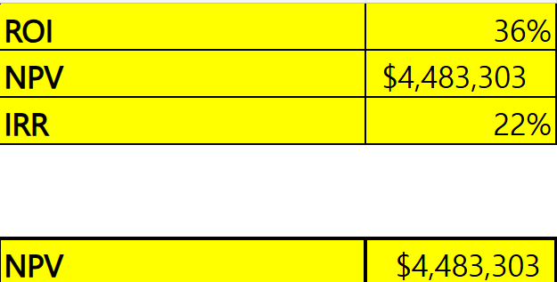
Financial Calculations

Slide 20
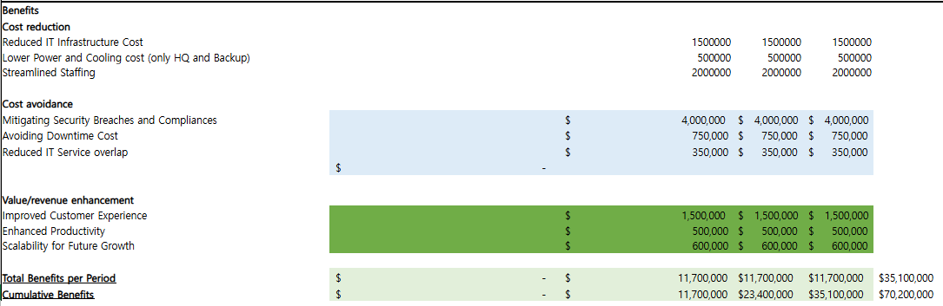
Financial Calculations

Slide 21
Extended Risks and Mitigation
Risk | Degree | Mitigation Strategy
The project may exceed its budget due to unforeseen costs related to technology, training, or resource allocation |  | Develop a detailed budget plan with contingencies for unexpected expenses. Regularly monitor expenses against the budget and adjust allocations, as necessary. Conduct a risk assessment at each phase to identify potential budget impacts early
The current IT staff may lack the necessary skills to implement and support new systems effectively |  | Assess current staff capabilities and identify skill gaps. Provide targeted training and hire necessary talent to fill critical roles. Consider partnerships with vendors for initial support and training
Dependence on external vendors for IAM and ITSM solutions may pose risks if the vendor fails to deliver as promised |  | Conduct thorough due diligence when selecting vendors, including checking references and evaluating their track record. Establish clear service level agreements with measurable performance metrics and have contingency plans for vendor failure
Severity
Probability
Severity
Probability
Severity
Probability

Slide 22
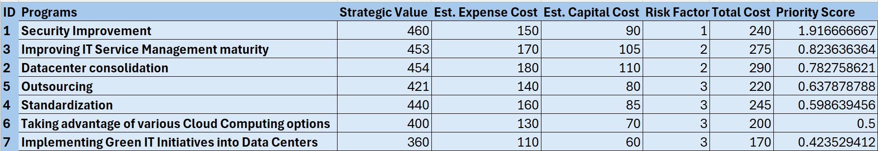
Other Options Considered
PPM Process and Allocation
ITS – IT Portfolio Management

Slide 23
Clear roadmap and key befits will set up LDI for a smooth implementation and transformation
Year 1 (Q1-Q4): Planning and Assessment & Initial Implementations
The first year focuses on planning, selecting vendors, and setting up the foundational systems such as the IAM system and IT service management. This stage sets the groundwork for all subsequent phases.
Year 2 (Q5-Q8): Implementation and Consolidation
In year two, the primary focus is on implementing the centralized IAM system and consolidating IT services. The second half of year two shifts toward data center consolidation and testing, ensuring that systems are optimized and fully integrated.
Year 3 (Q9-Q12): Final Deployment and Continuous Improvement
The final year completes the full deployment of systems, followed by comprehensive staff training and documentation. Continuous improvement measures are implemented to ensure the systems are scalable and adaptable to future changes. The final quarter is reserved for project evaluation and reporting to assess the impact of the transformation.
Smooth Transition
Scalable Approach
Continuous Support

Slide 24
Service and Helpdesk Consolidation will help LDI Increase Employee and Customer Retention
Consolidating LDI’s service desks is crucial because the current fragmented support system leads to delays and confusion among employees, decreasing their productivity and impacting the overall efficiency of IT services across the organization
Consistent Service Quality
Consolidating into a centralized helpdesk with standardized processes ensures that all employees receive the same level of support
This boosts overall service reliability and user satisfaction, which are crucial as LDI scales
Enhanced Transparency
With a unified ITSM platform, there’s a clear system for tracking and managing service requests and incidents
This enables faster resolutions and clearer ownership of issues which together make IT a more reliable business
Operational Efficiency
A centralized service desk reduces duplication of effort and improves efficiency
IT teams can track and resolve incidents more effectively, allocate resources better, and ultimately lower their operational costs

